Slide 1

Sushen-your medical assistant
An Android application for medical assistance
Submitted to :
Mr. Vinesh Jain Sir
Mrs. Jyoti Gajrani
Presented by :
Pratyut Sharma(15CS49)
Shivam Kasat(15CS71)
Amit Shukla(16CS102D)
Project Guide:
Dr. Neetu Sharma

Slide 2
Objectives achieved so far..
Patient Registration: Patient will successfully be able to register with credentials in app.
Doctor Registration: Doctor of the premise will be able to register into the application and there data will be recorded into the database.
Token Generation: Token will be generated for each and every patient.
Personalized User Space: A simple and user-specific UX/UI is created for easy use by the patient.

Slide 3
Features and Uses..
Location Constraint: Patient who specifically belong to Ajmer and nearby location will only be able to register there appointment with the doctor. So that no fake appointments can be created .
Complete database of all the doctors belonging to the premise will be available at one click.
Firebase is selected for database and API calls, so that further modifications can be done easily. Also due to its fast response towards data changes it was suitable for our needs.

Slide 4
Patient related data node include:
Email
Contact Number
Password
Record (of the previous Appointment including Doctor name and date of appointment)

Slide 5
Challenges faced during development
Problem of foreign login: will solved using location checking module where user’s location coordinate will be checked in range of lat-long.
Problem of separate login for doctor & patient: solved using creating different login panels for both of them.

Slide 6
Doctor data nodes will include
Name
Email
Contact Information
Field of Specialization

Slide 7
Future Target
Database of medicine available in the premise
Queue of the patients.
The presence of a respective doctor will be dynamically refreshed everyday.
List of precious appointments will be made available to patient.

Slide 8
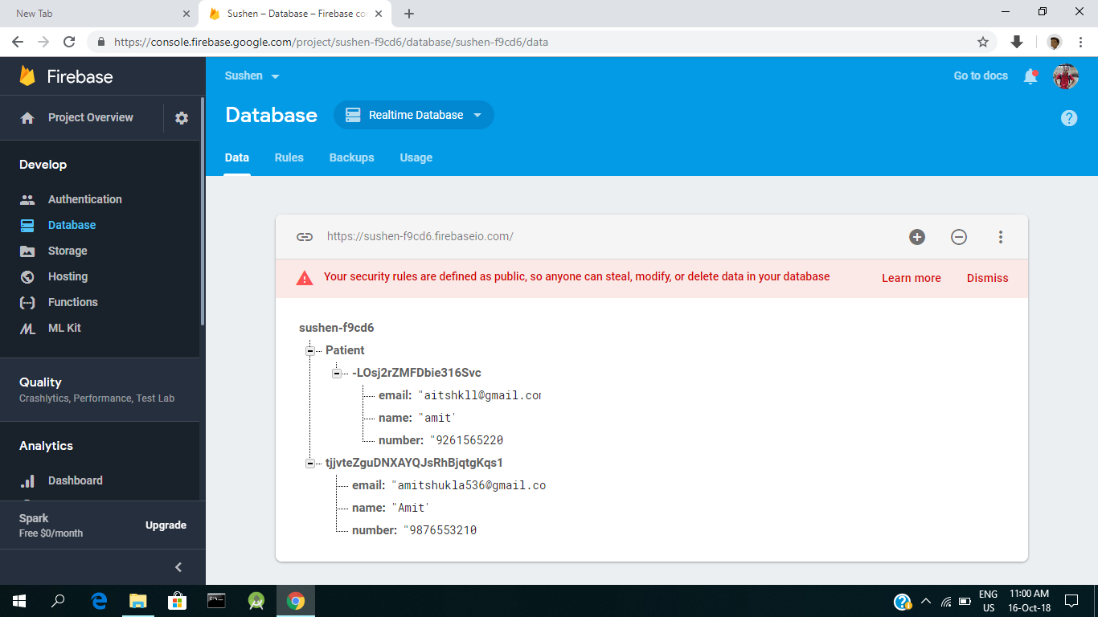
Database Snapshots..

Slide 9
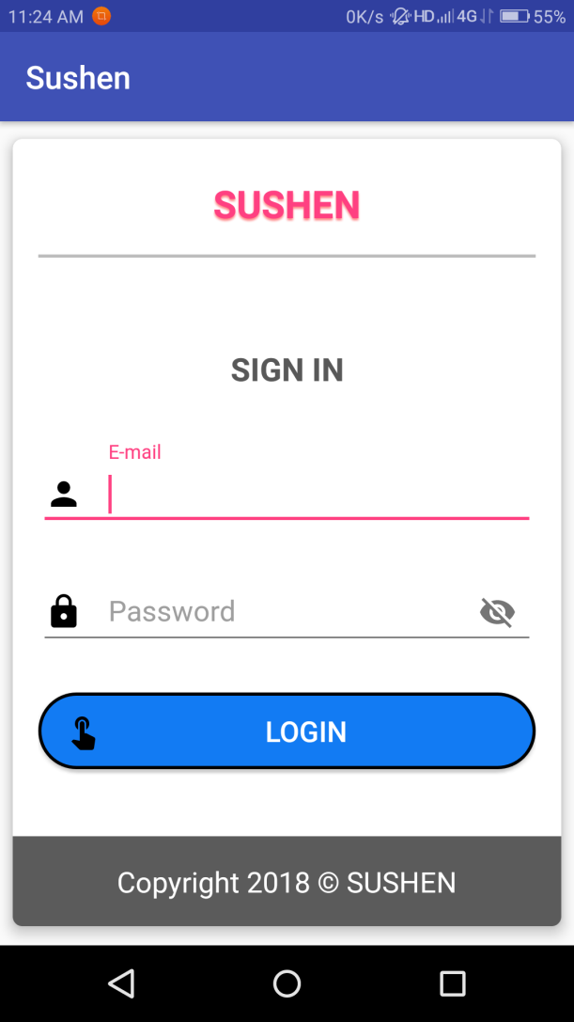
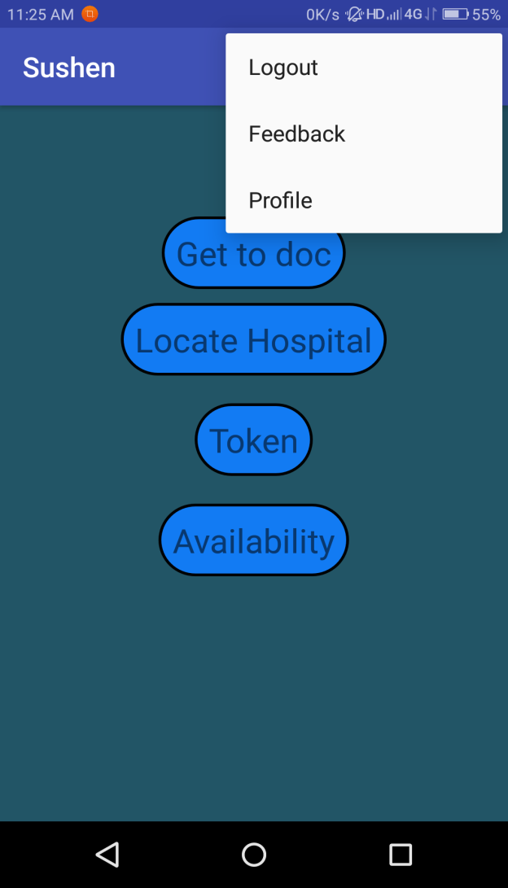
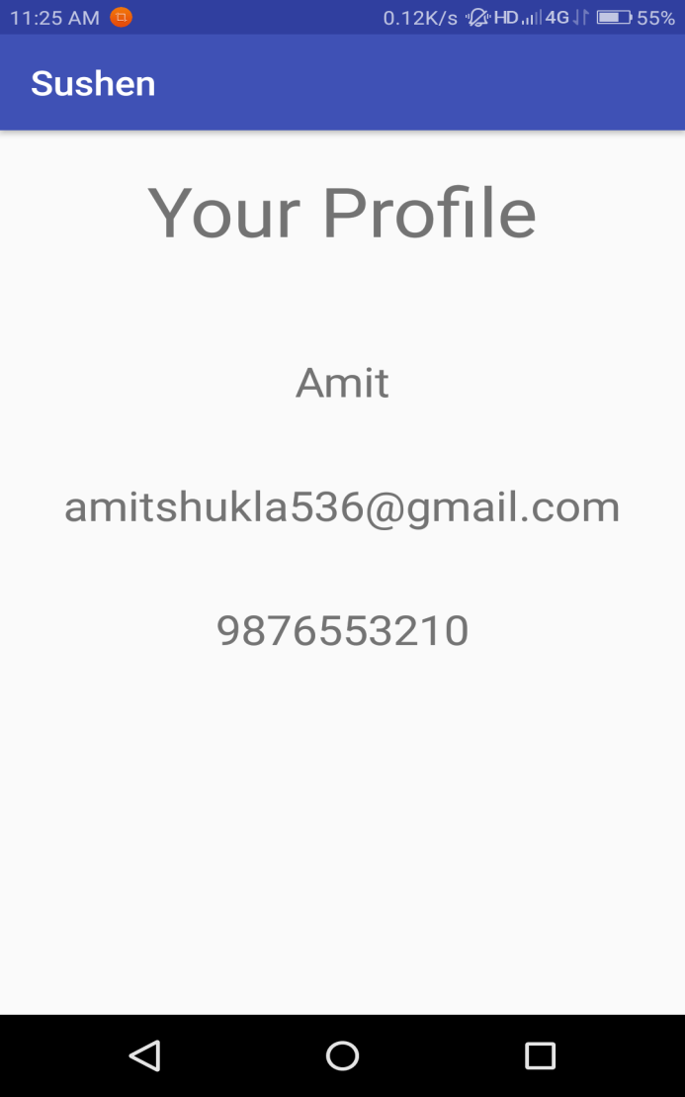
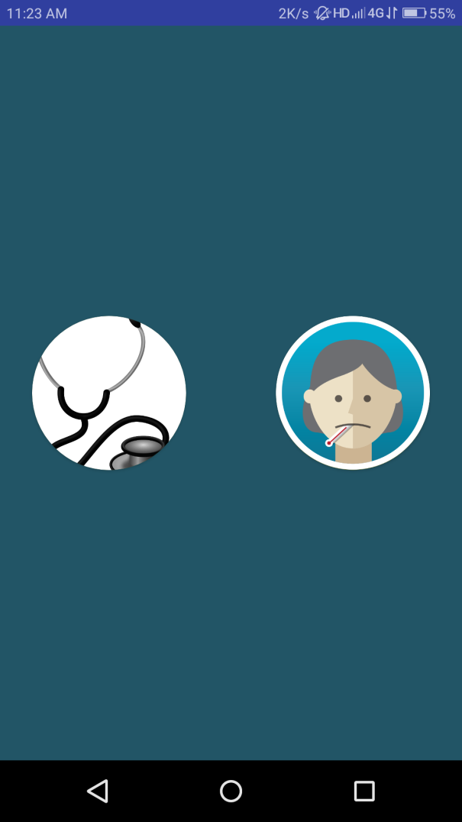
UI Snapshots:
OPTION USER
SIGN IN
PATIENT PAGE
PROFILE PAGE

Slide 10
Thank You …
We appreciate your Patience

